Slide 1
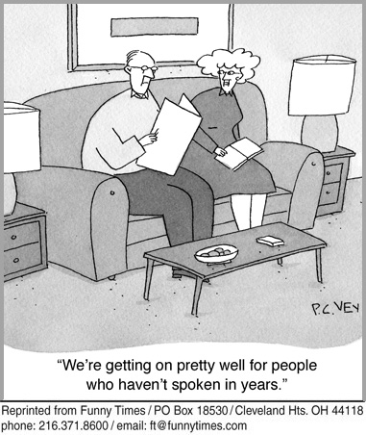
Marriage: A Changing Tradition

Slide 2
Family Law
Family Law deals with the various relationships between family members, including husband and wife, parents and children, and more recently same-sex partners.
The need for family law usually begins with the marriage breakdown—grounds for divorce.
The Constitution Act, 1867 gives the federal government authority to define the essentials of marriage, and provincial governments the jurisdiction over the solemnization of marriage (the procedures required for a legal marriage).

Slide 3
Changing Times
For many years, the traditional “nuclear family” was the dominant model for most homes.
A nuclear family consists of a mother, father, and their children.
Over the years this model has become less dominant and several newer models have emerged to create a diversity among families that is unprecedented.
Newer family models include: same-sex couples with children, single parents, married couples without children, unmarried couples in common law relationships, and, most recently, three-parent families.

Slide 4
Marriage
A marriage involves a legally binding contract between two people.
A divorce terminates the contract.
Similar to other contracts, each spouse has rights and obligations:
Each spouse has a right to live in the family home.
Spouses have a mutual obligation of financial support and an individual obligation of self-support.
Spouses have rights to share in an estate; one spouse gains rights to the estate if the other spouse dies.
If there are children, the partners must determine care, custody, and support in the event of a divorce.

Slide 5
Requirements of Marriage
Most of the essential requirements of marriage are recognized through common law, and each province has its own Marriage Act.
The essential requirements of marriage:
Mental capacity
Genuine consent
Minimum age
Close relationships
Unmarried status

Slide 6
Capacity & Consent
Mental Capacity
For a marriage to be legal, each person must have the mental capacity to understand the nature of the marriage.
Someone who lacks mental capacity because of illness, drugs, or alcohol cannot legally marry.
Genuine Consent
A marriage is not valid if either person did not freely consent, or agree to being married.
If either person is under duress (forced to marry) or if there is a mistake (marrying the wrong twin, communication problems), the marriage is not legal.

Slide 7
Minimum Age
In Canada, the English common law minimum ages for marriage have been adopted: 14 years old for males, and 12 years old for females (2 years younger because girls were thought to mature faster).
However, each province has its own version of the minimum age, all of which are higher than the common law ages, except for Québec.
Very young people who wish to be married require their parents’ permission by law.

Slide 8
Close Relationships
In Canada, a person cannot marry someone who is closely related to him or her (consanguinity).
A man cannot marry his…
mother
daughter
sister or half-sister
grandmother or granddaughter
A woman cannot marry her…
father
son
brother or half-brother
grandfather or grandson
Close relationships include adoptions.

Slide 9
Status
Both persons must be unmarried at the time of their ceremony.
In Canada, monogamy (being married to one person) is the only legal form of marriage.
Bigamy means being married to two people at the same time and is illegal.
Polygamy means being married to two or more people at the same time and it is also illegal.
If a person wants to remarry, that person must prove that his or her previous marriage has officially ended.

Slide 10
Solemnization
The formal requirements of marriage, known as solemnization, include
issuing a marriage licence or banns.
performing the marriage ceremony.
establishing age requirements.
registering the marriage officially.
The banns of marriage refers to an announcement of an intended marriage read in a couple’s church.
A ceremony may be civil or religious.
Before a wedding, a couple will obtain a marriage licence, and following the ceremony they receive a marriage certificate that registers their marriage.

Slide 11
Same-Sex Marriages
In 2005, the federal government passed the Civil Marriage Act, which changed the previous definition of marriage (“the lawful union of one man and one woman to the exclusion of all others”) to include same-sex couples.
The definition now speaks of “the lawful union of two persons” instead of “one man and one woman.”
Gay men and lesbian women successfully used their Section 15 Equality Rights in the Charter of Rights and Freedoms to have the definition changed.

Slide 12
A Spouse’s Name
One of the spouses, usually the wife, may choose to change his or her surname.
The options are:
Assuming the spouse’s surname.
Assuming a combination of one’s own surname and the spouse’s surname (with a hyphen in between).
Keeping one’s own surname and not changing it.
Each province has a Change of Name Act.
Today, it is common for women to keep their own surnames or combine them with their spouses’ surnames.

Slide 13
Some Things to Consider
If you were to plan a wedding, what traditional features would you include?
What innovations would you add?

Slide 14
What do you think you have to include?
Formal Requirements of a marriage
Marriage Licence
Marriage Ceremony
Must be witnessed by two people who are 18 years or older
Must be conducted by someone who is legally authorized to do so
Each party must declare that they are not aware of an
impediment to the marriage
Must take each other as his or her "lawfully wedded" husband or wife
The person conducting the ceremony must pronounce the couple as married

Slide 15
Jigsaw Activity
In groups of 6 will be assigned one of the
essential requirements of marriage.
Write a brief definition in your own words
of what that requirements means.
Use the textbook to help you - pages 414 -
418

Slide 16
Read and Answer
Read the Cases provided and answer the
questions. We will take them up as a class
1. Al-smadi
2. Barrett Estate v. Dexter
3. Pettkus v. Becker

