Slide 1
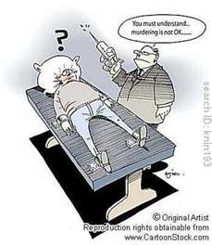
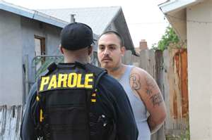
SENTENCING AND THE CORRECTIONAL SYSTEM

Slide 2
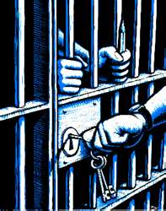
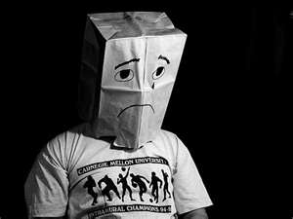
GOALS OF SENTENCING
RETRIBUTION
“EYE FOR AN EYE”??
DETERENCE
“DON’T DO IT… AGAIN”
REHABILITATION
“BE A RESPONSIBLE CITIZEN”
PROTECT THE
PUBLIC
RECIDIVISM
“REPEATERS”
RESTITUTION
“PAY-BACK SOCIETY”
DENUNCIATION
“SHAME ON YOU!”

Slide 3
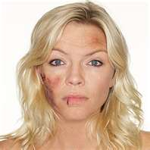
SENTENCING PROCEDURES
PERSPECTIVES TO CONSIDER
THE OFFENDER
PRE-SENTENCE REPORT – What is background info?
ex. Family, past, mental health, etc.
PSYCHIATRIC ASSESMENT
THE VICTIM
VICTIM IMPACT STATEMENT – Describes harm or loss.
SOCIETY
Safety- Previous Record, Time incarcerated.
SENTENCING HEARING – The judge will determine
an appropriate sentence.
Aggravating Factors - Criminal record, severity, attitude, impact statements.
Mitigating Factors - circumstances, employment, remorse, health, etc.

Slide 4
TRADITIONAL SENTENCES
QUESTIONS A JUDGE MUST ASK HIMSELF:
1. Can rehabilitation work?
2. Will he be a threat to others?
3. Is restitution warranted?
4. Will we make things worse? (YOA)
OPTIONS
1. DISCHARGES
Releasing ‘the bad guy’ for minor or 1st offences
ABSOLUTE DISCHARGE
- release and erase criminal record after one year.
CONDITIONAL DISCHARGE
- released on conditions: avoid contact, no booze or drugs, curfew etc.
- after 3 yrs. record destroyed.
- if broken = more severe punishment

Slide 5
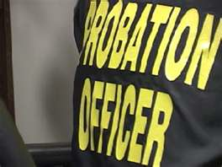
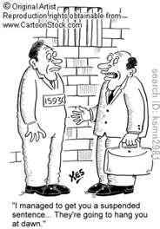
2. PROBATION - Allows the offender to live in community under
supervision of a probation officer.
CONDITIONS: a. Keep the peace & good behavior.
b. Appear in court when required.
c. notification in any changes (name, address, job, etc.)
OPTIONAL CONDITIONS: Report regularly, known associates,
specific locations, counseling, drugs, and alcohol.
3. SUSPENDED SENTENCE - Judge opts for no
sentence provided certain requirements are
met .
- Minor offences or 1st time offender
- Cannot have a CCC minimum sentence

Slide 6
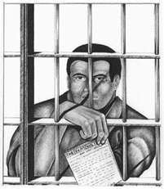
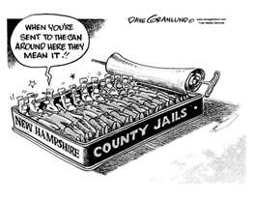
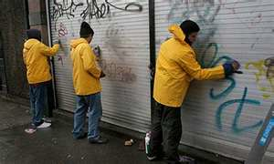
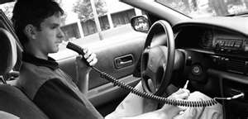
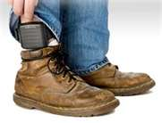
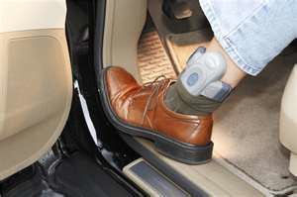
4. INTERMITTENT
SENTENCE
Served on weekends and nights
- less than 90 day sentence.
- non violent, jobs, families.
- probation when ‘out’
5. CONDITIONAL
SENTENCE
A prison that can be served in the
community.
- can’t have minimum sentence.
- usually stricter than probation.
- community service, addiction
centers.
6. ELECTRONIC
MONITORING
Sentence served at home while
being monitored with an electronic
ankle bracelet.
- can = breath samples, video, etc.
7. SUSPENSION OF
PRIVILEDGES
Taking away specific privileges.
- Driving, Firearms, Hometown???
What effect do these
have on prisons?

Slide 7
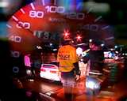
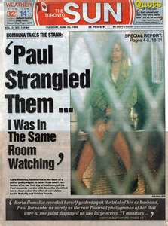
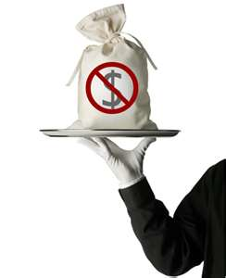
8. BINDING OVER/PEACE BOND
Good behavior for 12 months.
- Like a restraining order (R.O. = Temporary)
- Ex. Placed on someone who issues a
threat.
- If broken = a crime.
9. DEPORTATION
Expulsion from the country.
- Indictable offence of non-
Canadian.
PG
Gangster with no citizen-
Ship papers facing deportation
Vancouver
Chinese street racer
Faced deportation after
Killing pedestrian
10. PLEA BARGAINING
A negotiated deal; guilty plea usually for
a lesser sentence.
Controversial ???
Karla Homolka
Testimony for two
12yr. Sentences
served concurrently.
11. FINES
Money paid as a penalty for crimes

Slide 8
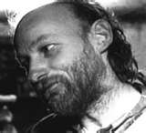
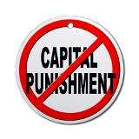
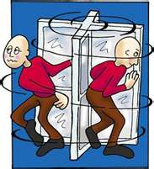
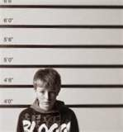
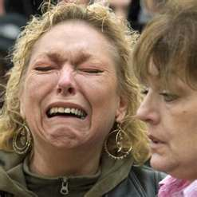
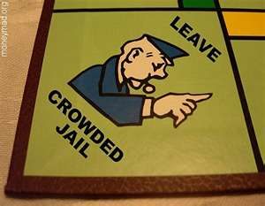
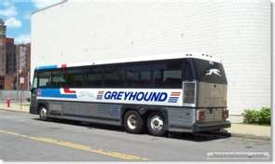
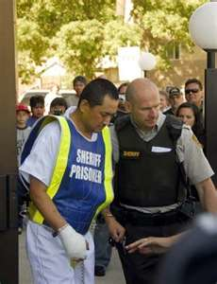
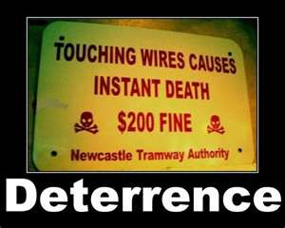
INCARCERATION – “Jail Time”
Must be for a specified length of time (Max. = 25yrs.).
NOTE – Dangerous offenders can = Indeterminate Sentence (Indefinite)
Concurrent Sentence – Sentences served at the same time.
Consecutive Sentence – Sentences served one after the other.
JAIL TIME
________ PROs CONs________

Slide 9
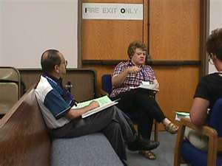
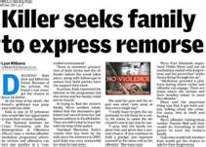
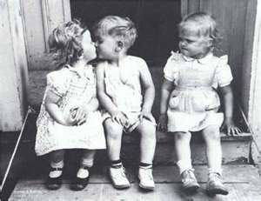
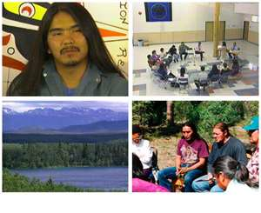
RESTORATIVE JUSTICE PROGRAMS
Focuses on using joint problem solving techniques that
involves the offenders, victims, & community
(Restore, rebuild, reconciliation, forgiveness, remorse)
VICTIM-OFFENDER MEDIATION
FAMILY GROUP CONFERENCING
VICTIM-OFFENDER PANELS
ABORIGINAL SENTENCING
CIRCLE
Mediated make-up??
Would Sent. Circles work
For non-Aboriginals?

Slide 10
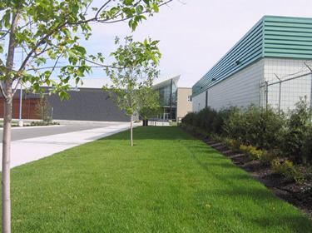
THE CORRECTIONAL SYSTEM
Can.’s approach = ‘Get Tough’ with violent => alternatives for low risk offenders.
THE FACTS
The toughest and most costly penalty we have.
$3 billion / yr.
$95,000/indiv./yr. => Parole = 2-9,500 / yr.
120 prisoners/100,000 => 75% fewer than the USA
No proof that prisons “work.” (Re: Goals)
Google P.G. Corrections
= DPSS ??????

Slide 11
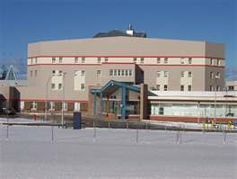
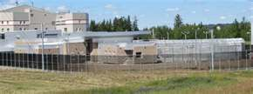
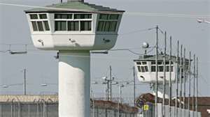
PROVINCIAL CORRECTION
SYSTEM
- Awaiting trial or a sentence < 2 yrs.
1. Open Custody
- Less secure Ex. Halfway House
- Non-Violent / Non-Flight Risk
2. Protective Custody
- Separation of prisoners.
- Psychological Care
- Require Protection
3. Closed Custody
- Secured facility
- Dangerous
- Flight Risk
FEDERAL CORRECTION
SYSTEM
Sentences of over two years.
1. Minimum Security
- No external barriers.
- Unarmed gaurds
- Employment & ed. programs
2. Medium Security
- Few external barriers
- Fewer gaurds
- More freedom & contact
3. Maximum Security
- Wall, razor wire, bars, fences.
- Armed gaurds
- Dangerous offenders
P.G. Correctional Center
Canada’s Special Handling Unit, Quebec
Our version of US, supermax prison
New PGCC women’s wing

Slide 12
JAIL TIME
________ PROs CONs________
CORRECTIONAL PROGRAMS
Rehabilitation with a plan; needs, priorities, school, work, etc.
LIFE SKILLS -SUBSTANCE ABUSE PROGRAMS
LITERACY SKILLS -SEX OFFENDER TREATMENT
WORK EXPERIENCE -FAMILY VIOLENCE PROGRAMS
COGNITIVE SKILLS TRAINING

Slide 13
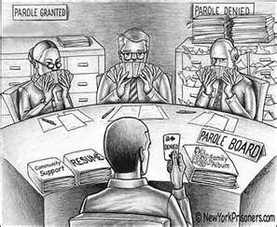
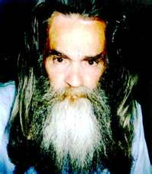
PAROLE
Release of inmate before the full sentence is
served on a promise of good behavior.
Must be reviewed after 1/3 of sentence
or 7 yrs. (Which ever = 1st)
Exception = 1st Degree Murder.
Why is this good? Why is this seen as ‘bad’?
The National Parole Board will make this decision based on:
Risk - The Offence
Social Issues (Drugs) - Mental Status
Behavior - Criminal History
Employment - Family
Advice (Police, Shrink) - Victim Impact Statements
Treatments - Chance of success
Video – Parole / Recidivism
See Latimer p. 340 / Differences????
Public Perception??

Slide 14
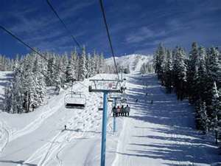
RELEASES
CONDITIONAL RELEASE – Serving part of the sentence in
the community under supervision.
UNESCORTED TEMPORARY ABSCENCE– brief release from
custody for community service or personal reasons.
DAY PAROLE – Conditional absence from
prison for the day.
FULL PAROLE – conditional release after
serving 1/3-1/2 of sentence.
STATUTORY RELEASE – Release by law after 2/3 of sentence.
CONDITIONS – report, obey law, carry release card, no weapons,
meet all curfew & report times.
PG / 100 Mile
Murderer ski day?????

Slide 15
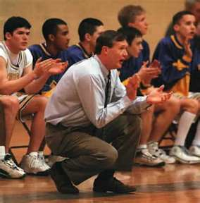
PARDONS
The setting aside of a person’s conviction.
Charges will be filed away and can only
be released by Solicitor General.
Foreign countries may not recognize.
Can apply for pardon: Summary after 3 yrs.
Indictable after 5 yrs.
Can be revoked if break law, or false information.
Royal Prerogative of Mercy
sentence reduction or release
by the Queen.
MSS Coach

